Slide 1
Top 3 Accomplishments
Ruslan Salakhutdinov and Brandon Houghton

Slide 2
Vorticity data augmentation
Developed framework for dramatically increasing the amount of data for training neural networks by augmenting existing vorticity simulations with transformations that preserve the local dynamics
Augmented data made network more robust

Slide 3
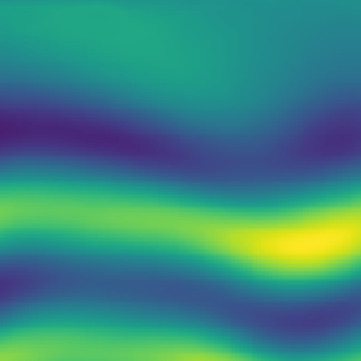
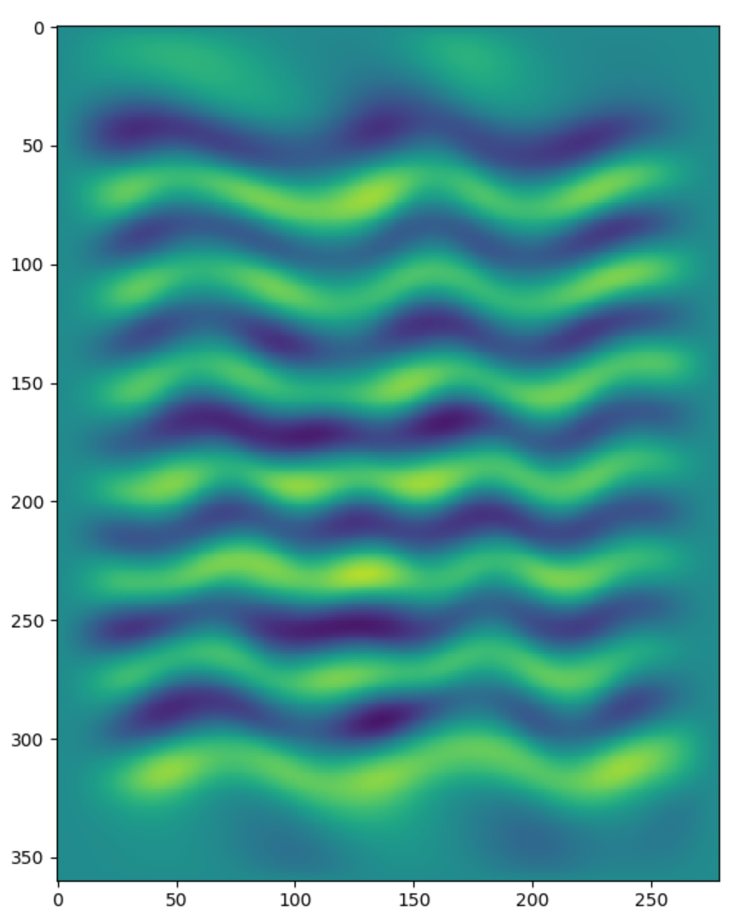
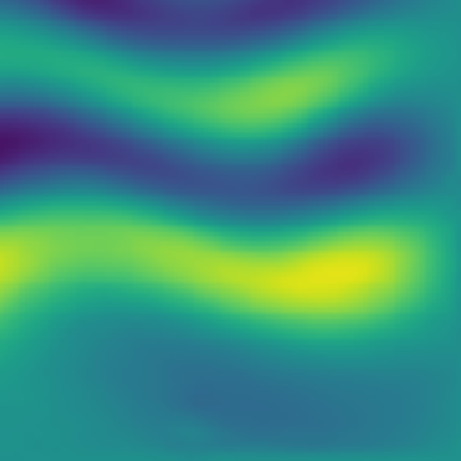
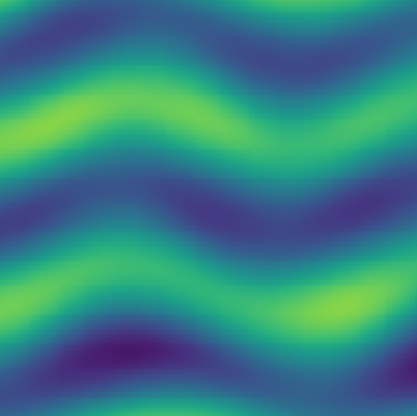

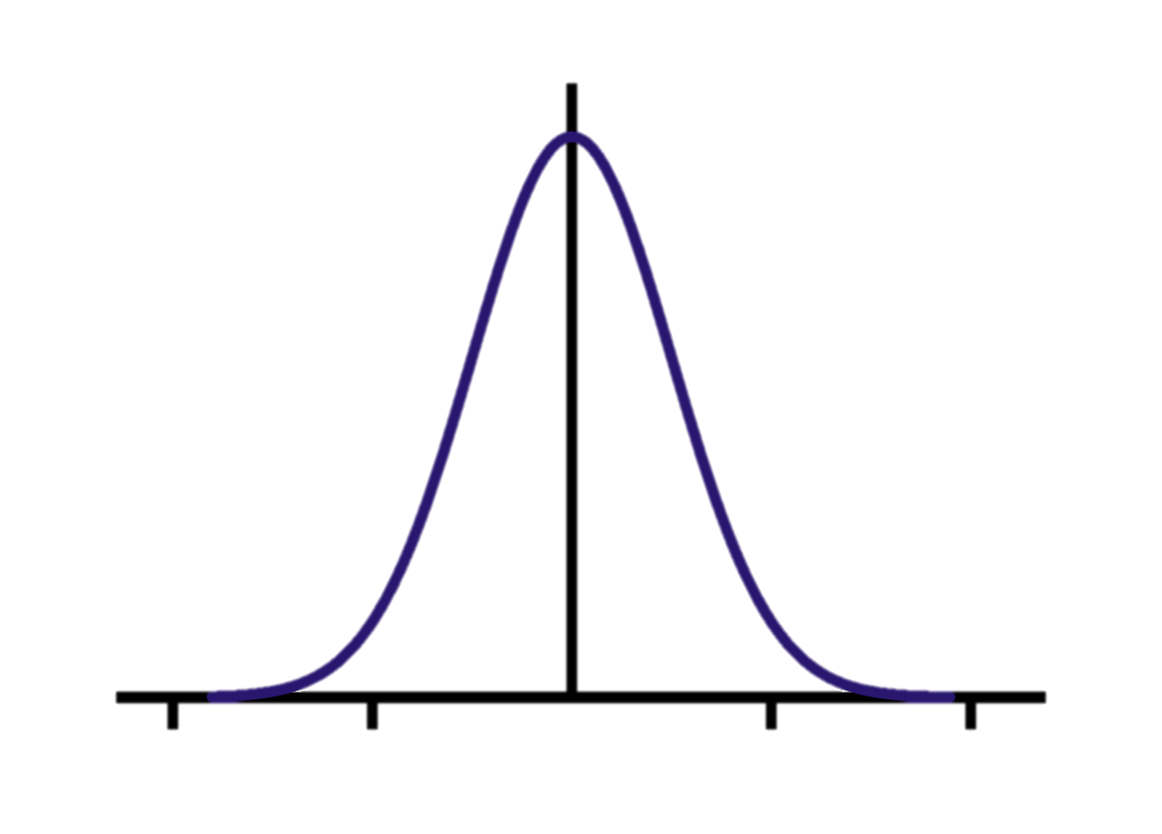
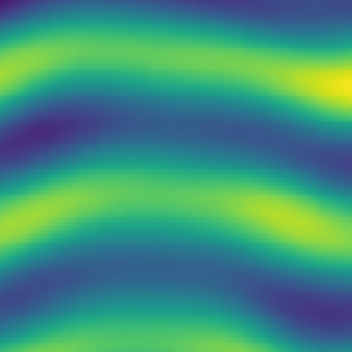

Vorticity data augmentation
Applying Transformations
Vorticity Data
Sampling Patches
rotation
noise
1000 samples
100,000 samples
mirror
Neural network can memorize entire sequence.
Not enough samples for train / test split
Neural network can memorize difficult patches.
Train / test split leaves plenty of samples
100,000,000,000+ samples
Allows training of larger, deeper neural networks

Slide 4
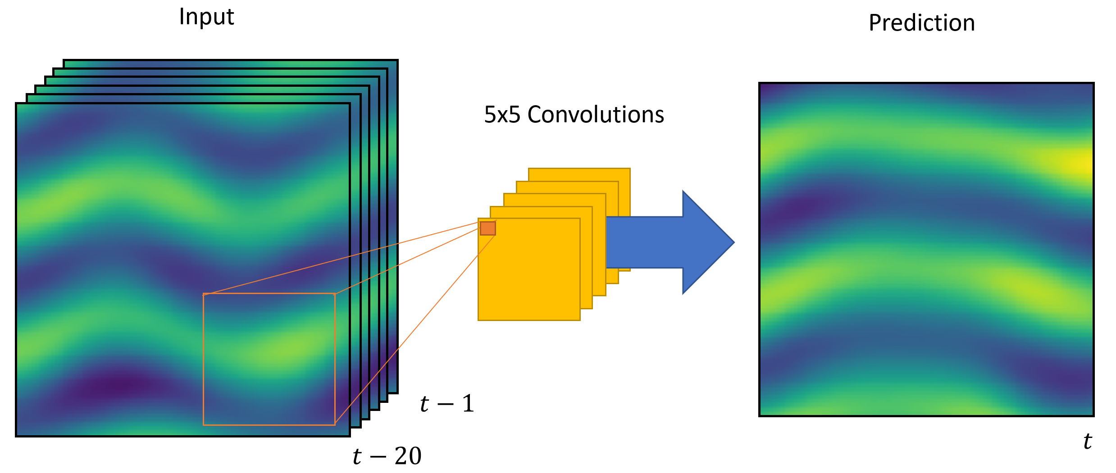

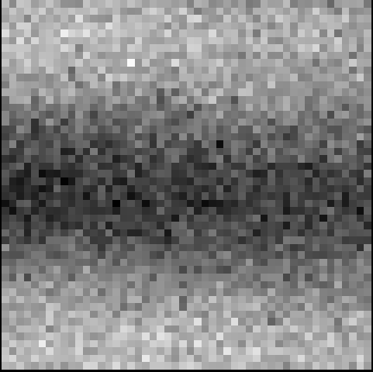
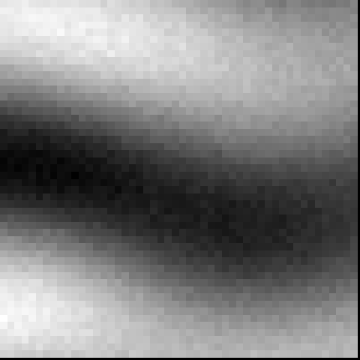
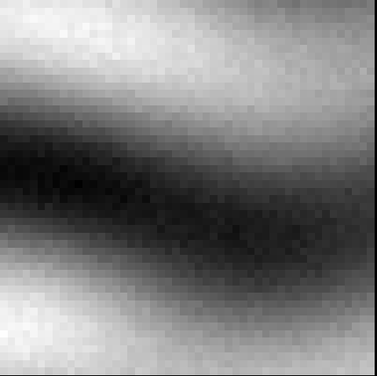
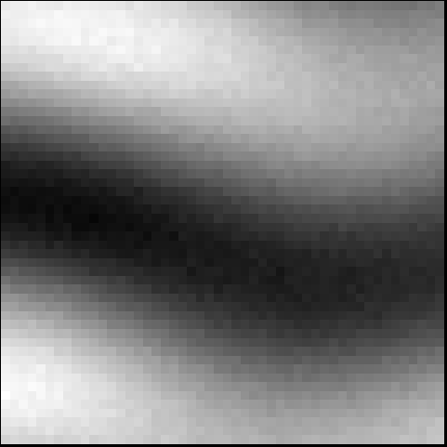
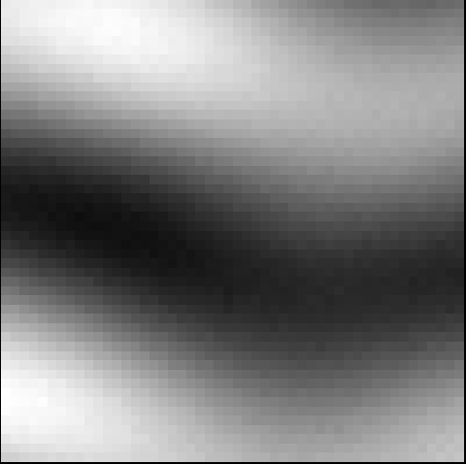
Predicted fixed horizon local vorticity
Developed network architecture for predicting future vorticity
Trained models are capable of predicting the future vorticity field using only local history for a given patch
Ground Truth
Predicted vorticity across training epochs

Slide 5
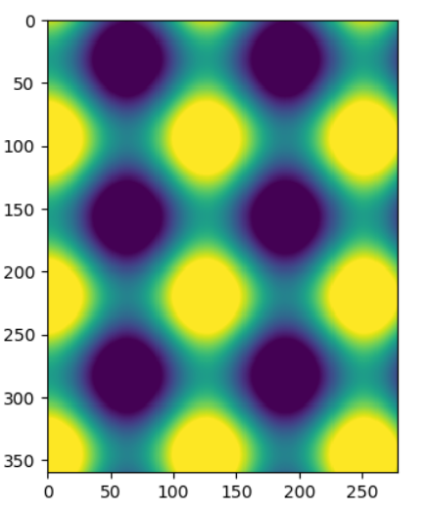
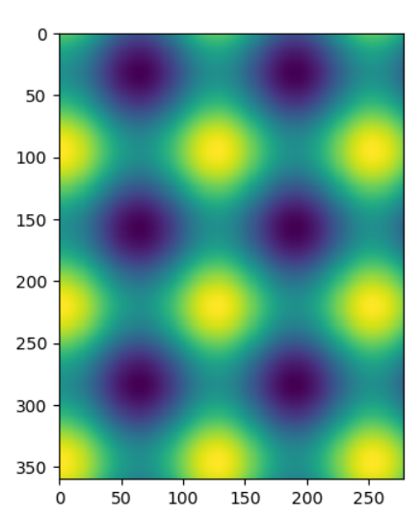
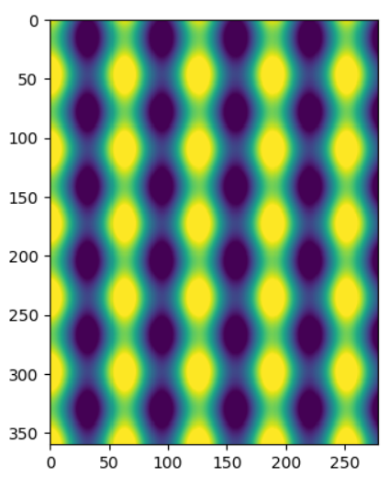
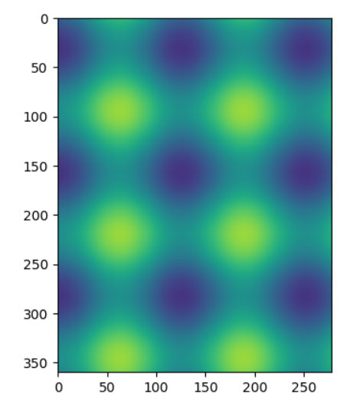
Periodic field generation
Simple periodic field simulation for learning procedure validation
Enables validation of network architectures
Low-dimensionality allows for smaller auto-encoder layers enabling faster testing and development

